Slide 1

Sales Insights: Analyzing Transactional Data from February to May
Prepared by :
Osama Adel

Slide 2
About Topic :
-Welcome to our presentation on sales data analysis and
its impact on business growth.
- In this session, we will explore the power of data analysis
by delving into a comprehensive dataset consisting of
four key tables: Sales, Reps, Products, and Stores.
-By leveraging this rich dataset, we will uncover valuable
insights that can help drive informed decision-making,
optimize sales strategies, and ultimately, enhance
business performance.

Slide 3
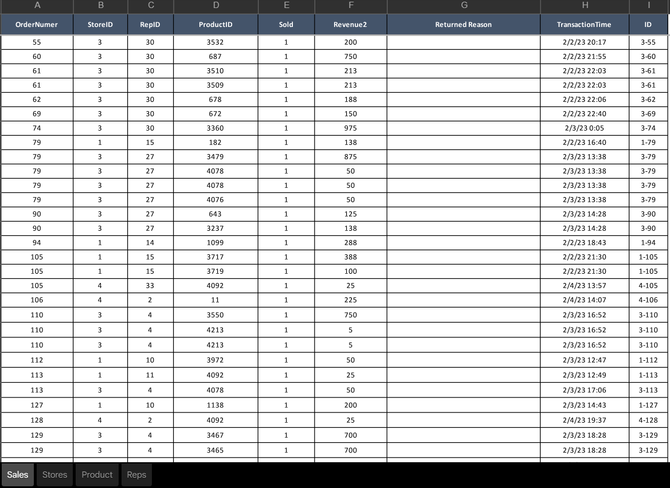
Original dataset using in the Project (Excel file)
the primary source of data is an Excel spreadsheet
containing four tables: Sales, Product, Stores, and
Reps. These tables provide valuable information
about the sales transactions, products, store
locations, and sales representatives associated with
the business.

Slide 4
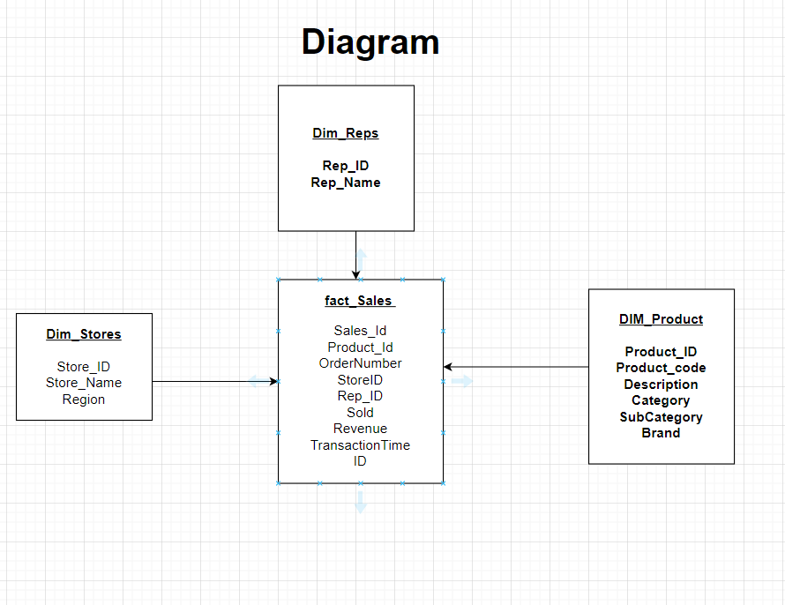
Making (DWH Modeling) using untitled diagram
-In this presentation, I have utilized an
Untitled Diagram to visually represent the
concept of data warehouse modeling. The
image aims to provide a simplified
representation of the key components and
relationships involved in the data
warehousing process.

Slide 5
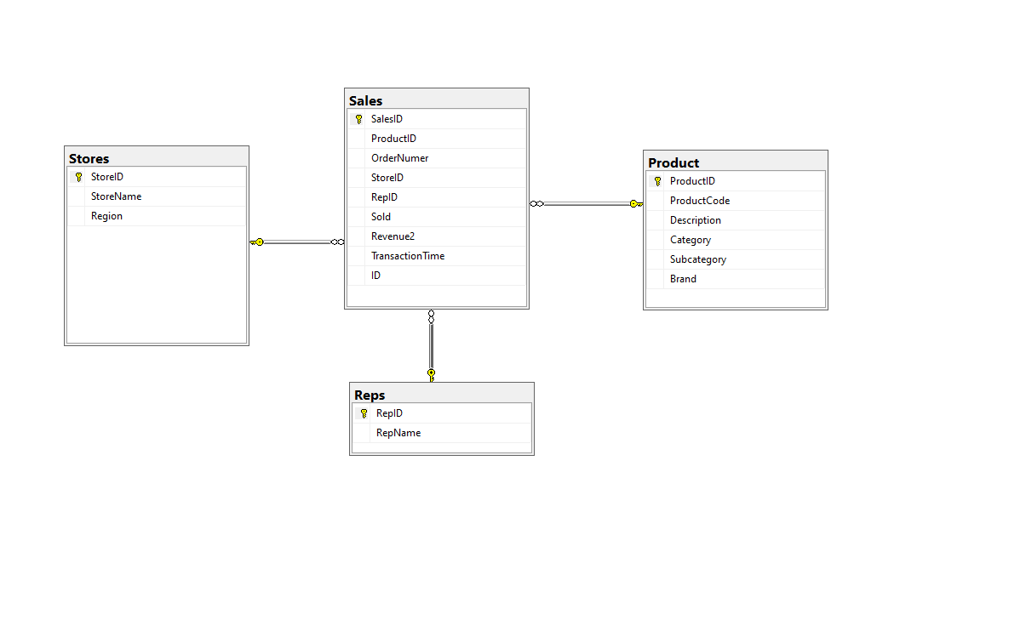
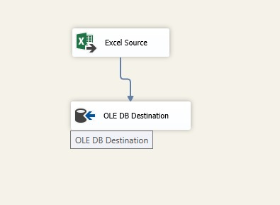
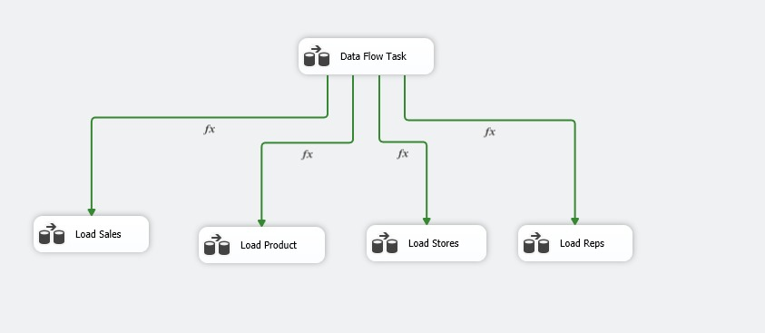
Creating DWH using Sql Services Tools :
-BY Integration we can involve combining the
different tables based on common identifiers.
-BY preparing and integrating the data
effectively, we can ensure a coherent and
reliable analysis.
e
Star Schema
SSIS

Slide 6
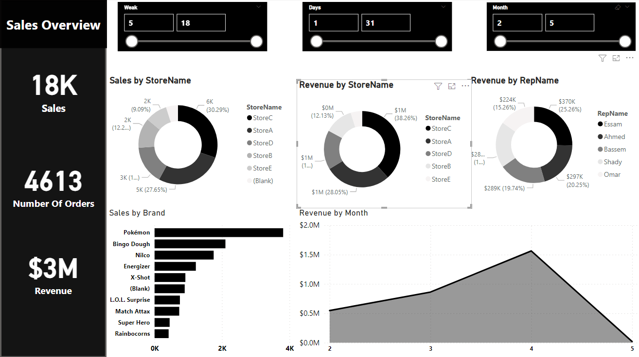
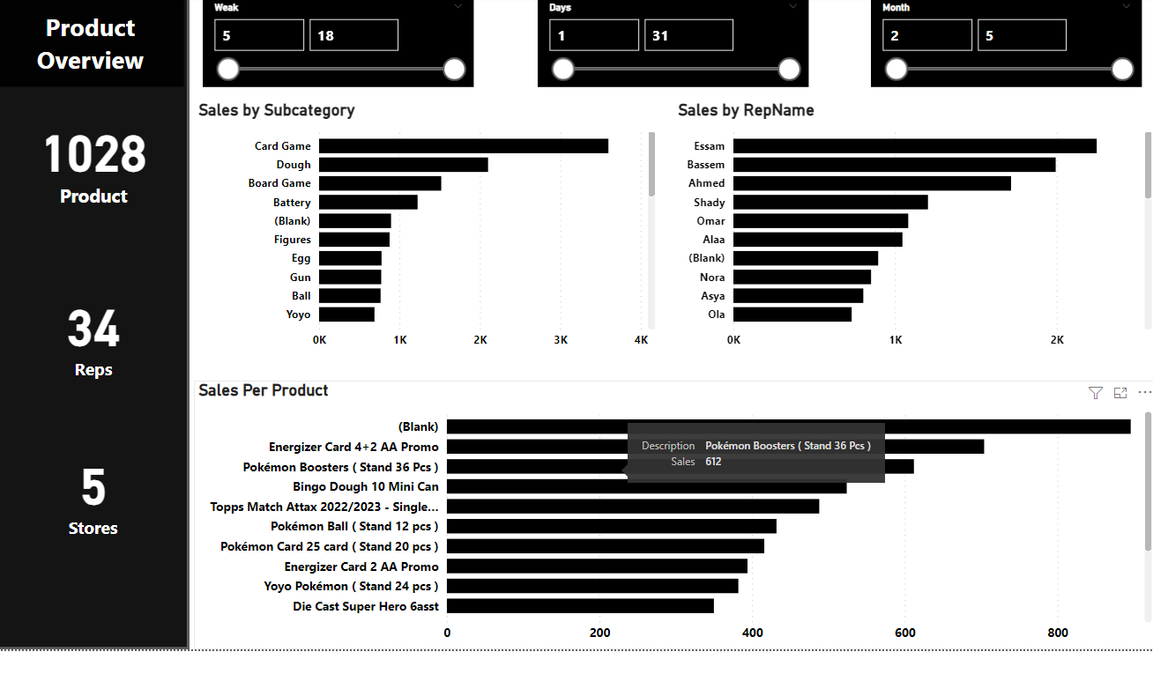
Data Visualization with Power BI:
utilized Power BI to create a dashboard focused on sales data. The dashboard incorporates Five key tables: Sales, Product, Stores,Dates, and Reps. This combination of tables allows for comprehensive analysis and visualization of sales-related information.

Slide 7
Thank You

